Slide 1

Project Presentation On “Housing Price Prediction Project”
Prepared By: Rajashri Sadafule Darveshi

Slide 2
Agenda
Overview.
Problem Statement.
Problem Understanding.
What is Housing Price Prediction?
Importance of housing price prediction.
Exploratory data analysis.
Visualizations.
Analysis.
Data cleaning steps.
Model Building.
Hyper Parameter Tunning.
Saving the model and predictions from saved best model.
Conclusion.

Slide 3
Overview
How to analyze the dataset for Housing Price Prediction.
Do EDA steps in cleaning the dataset.
Analysis of Housing Price Prediction.
Model building for training dataset.
Predicting Housing Price with best model for test dataset.

Slide 4
Problem Statement
Housing prices are an important reflection of the economy, and housing price ranges are of great interest for both buyers and sellers. In this project, house prices will be predicted given explanatory variables that cover many aspects of residential houses. The goal of this project is to create a regression model that are able to accurately estimate the price of the house given the features.

Slide 5
Problem Understanding
House price prediction can help the developer determine the selling price of a house and can help the customer to arrange the right time to purchase a house.
House Price prediction, is important to drive Real Estate efficiency. As earlier, House prices were determined by calculating the acquiring and selling price in a locality.
Therefore, the House Price prediction model is very essential in filling the information gap and improve Real Estate efficiency.
The aim is to predict the efficient house pricing for real estate customers with respect to their budgets and priorities.
By analysing previous market trends and price ranges, and also upcoming developments future prices will be predicted. Cost of property depending on number of attributes considered.
Now as a data scientist our work is to analyse the dataset and apply our skills towards predicting house price.

Slide 6

What is Housing Price Prediction?
Prediction house prices are expected to help people who plan to buy a house so they can know the price range in the future, then they can plan their finance well. In addition, house price predictions are also beneficial for property investors to know the trend of housing prices in a certain location.

Slide 7

Importance of Housing Price Prediction.
House Price prediction, is important to drive Real Estate efficiency. As earlier, House prices were determined by calculating the acquiring and selling price in a locality. Therefore, the House Price prediction model is very essential in filling the information gap and improve Real Estate efficiency.

Slide 8
About the data
1. Number of data points in train data:1168
2. Number of features in train data: 81
3. Number of data points in test data: 292
4. Number of features in test data: 80

Slide 9
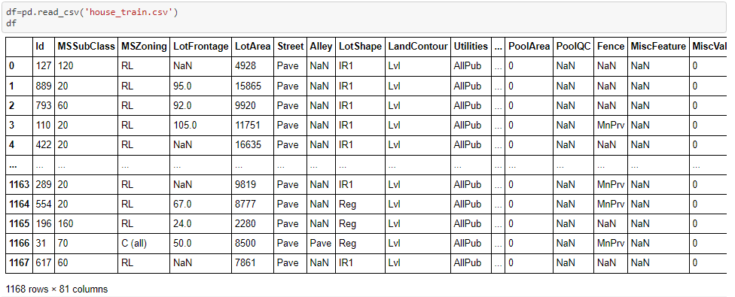
Exploratory Data Analysis
Importing required libraries.
Imported both the datasets which were in csv format.

Slide 10
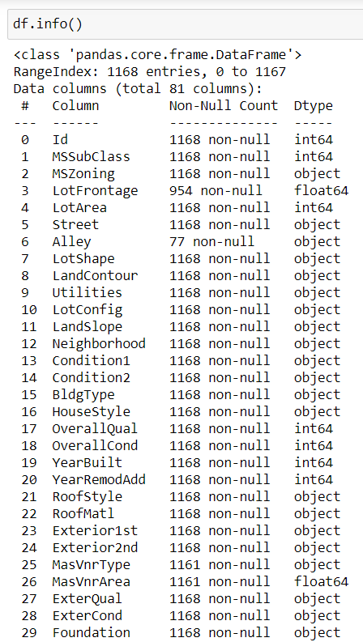
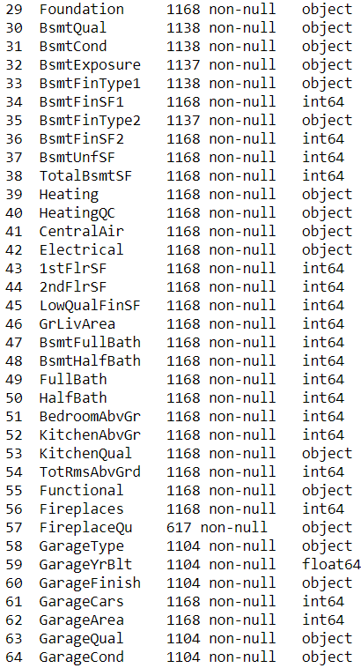
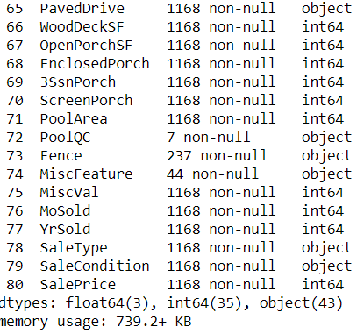
We have combination of numerical and categorical.

Slide 11
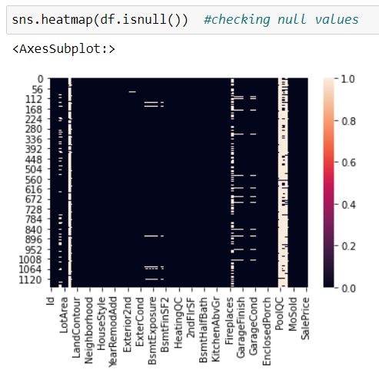
Checking null values in dataset
In dataset ID is just for serial number not giving any information so we will drop ID column. Then 'Alley’, 'MiscFeature’, 'PoolQC' these columns are having more than 80% NA data so we will drop these columns

Slide 12
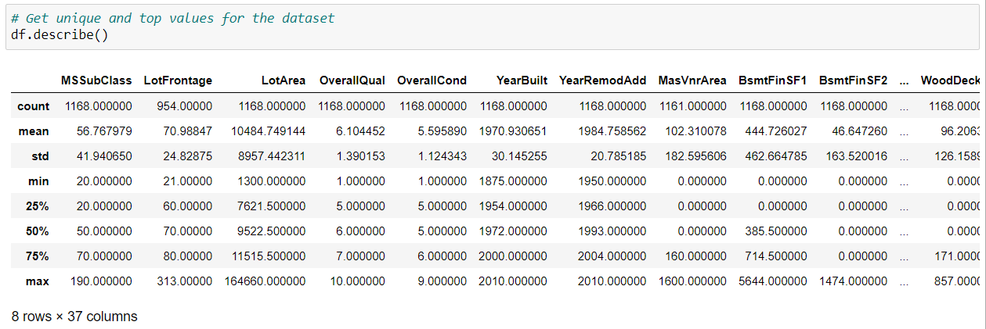
Statistical Analysis of dataset
Statistical analysis like checking shape, nunique, value counts, info describe etc

Slide 13
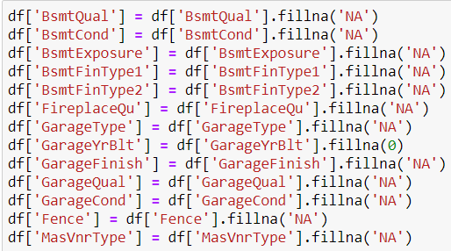
Filling NA data
While checking the info of the datasets, found some columns with more than 80% null values
Features LotFrontage, MasvnrArea, GarageyrBlt will fill NA with mean values
Now remaining null catogoricle features values will replace with NA
While checking for null values I found null values in most of the columns and I have used imputation method to replace those null values (mode for categorical column and mean for numerical columns).

Slide 14
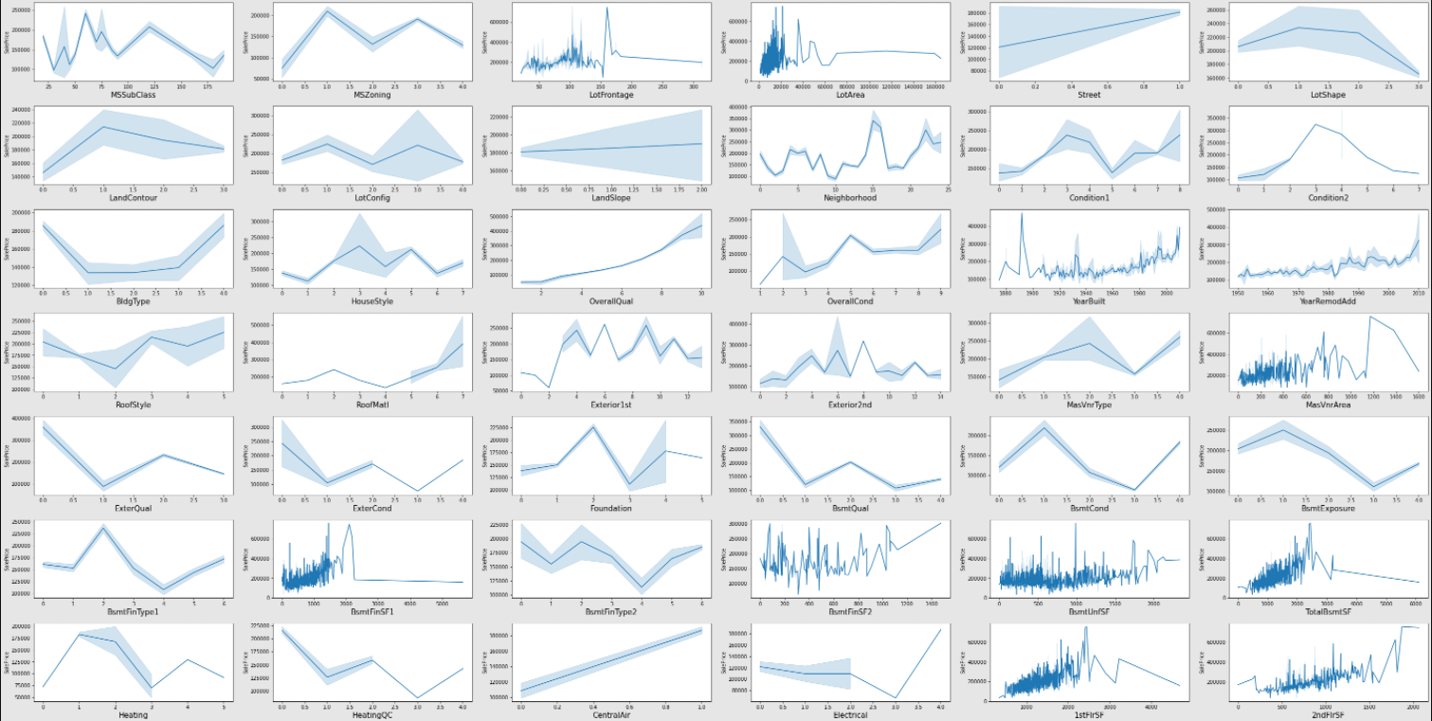
Visualizing the outliers using the lineplot

Slide 15
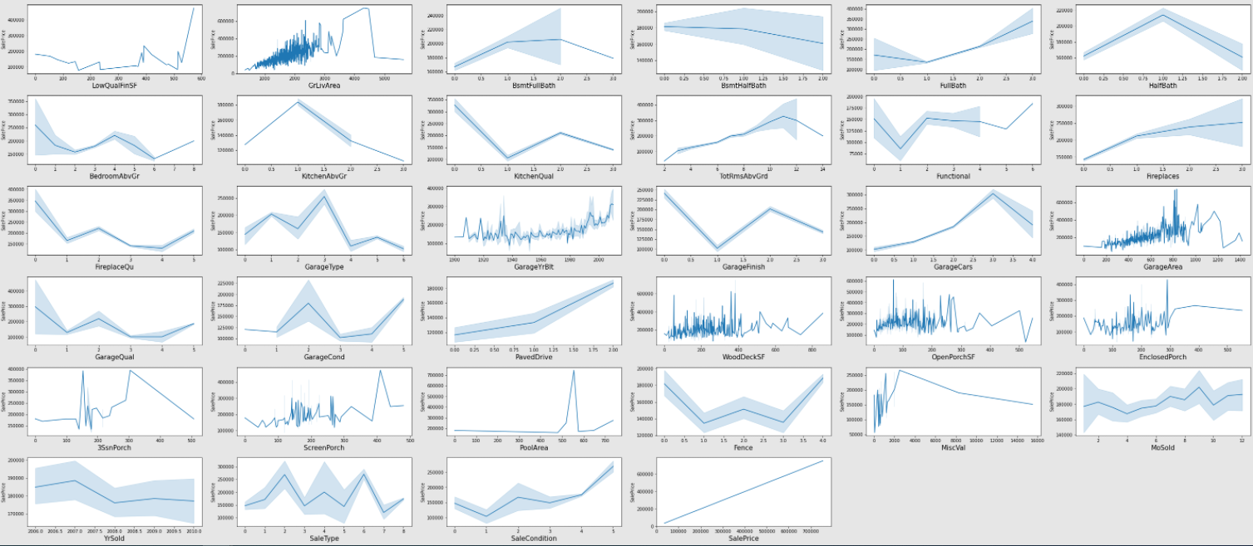
Visualizing the outliers using the lineplot

Slide 16
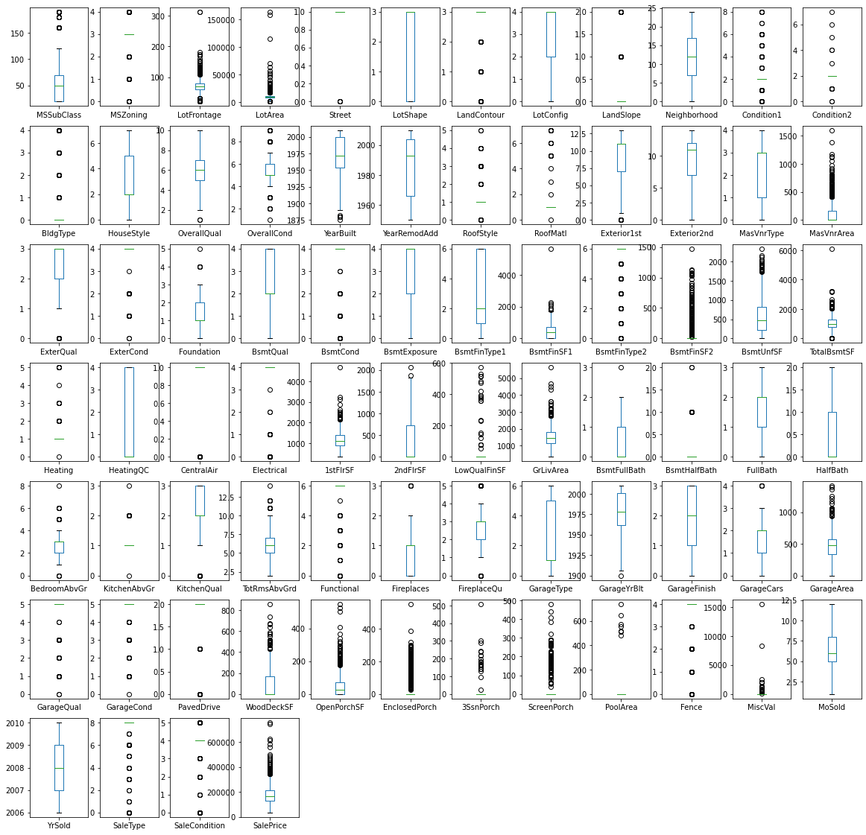
Visualizing the outliers using the boxplot

Slide 17
Observation
Box plot for each pair of categorical features that shows the relation with the median sale price for all the sub categories in each categorical feature. And also for continuous numerical variables I have used reg plot to show the relationship between continuous numerical variable and target variable.
Found that there is a linear relationship between continuous numerical variable and SalesPrice.
we can observe these features are having outliers 'LotFrontage', 'LotArea','MasVnrArea’, 'BsmtFinSF1', 'BsmtFinType2', 'BsmtFinSF2', 'BsmtUnfSF', 'TotalBsmtSF','1stFlrSF', 'LowQualFinSF', 'GrLivArea’, 'GarageArea’, 'WoodDeckSF', 'OpenPorchSF', 'EnclosedPorch', '3SsnPorch', 'ScreenPorch', 'PoolArea','Fence’, 'MiscVal’, 'SaleType’, 'SaleCondition' we will try to remove outliers with zscore

Slide 18
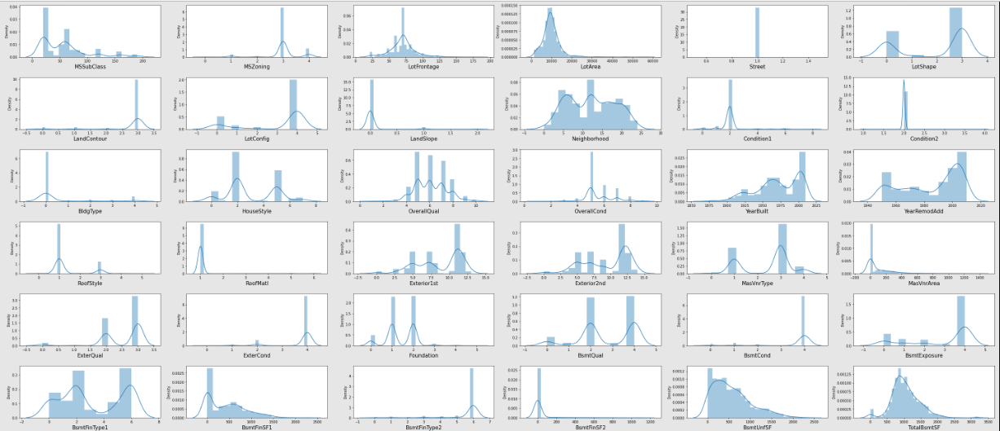
Distplot before Removing outliers by Zscore

Slide 19
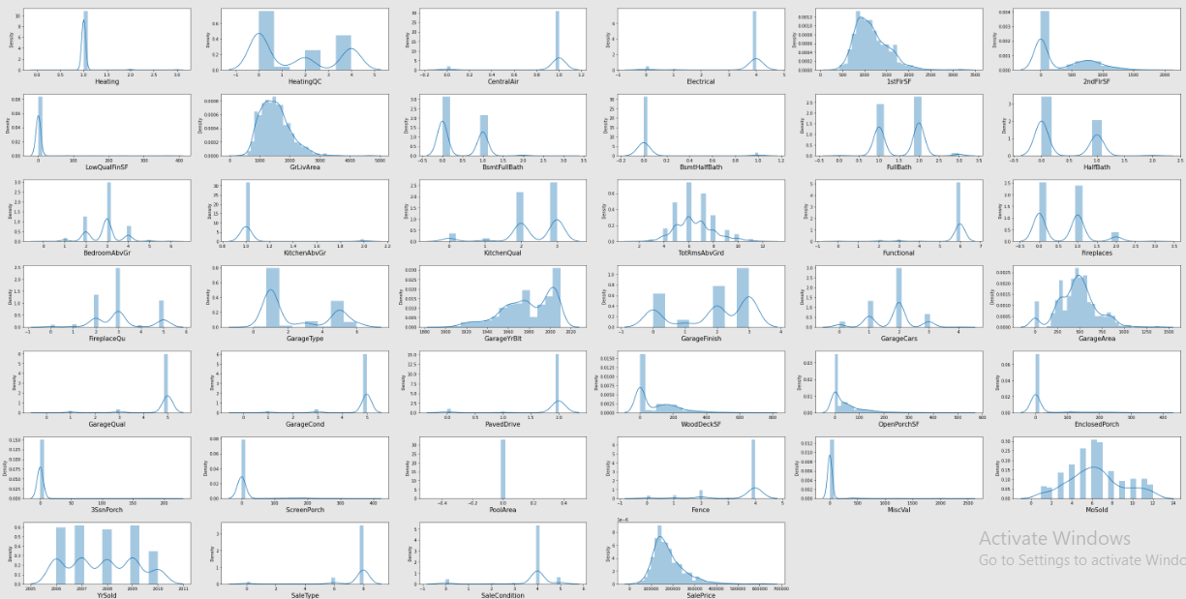
Distplot before Removing outliers by Zscore

Slide 20
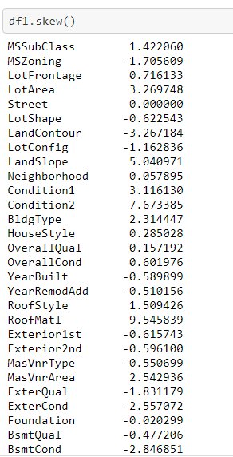
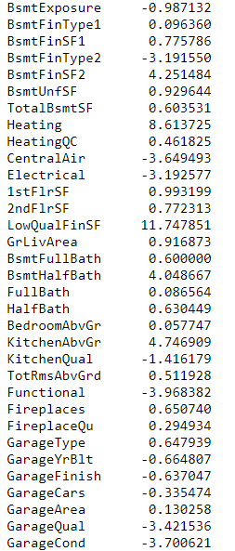
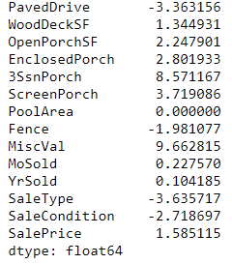
Observation:
After removing applying Zscore method data loss is 4.2%, Which is less than 5%.
Still some feature are having skewness or outlier present.
Now we will do power transformation technique to treat the skewness in the data yeo-johnson¶

Slide 21
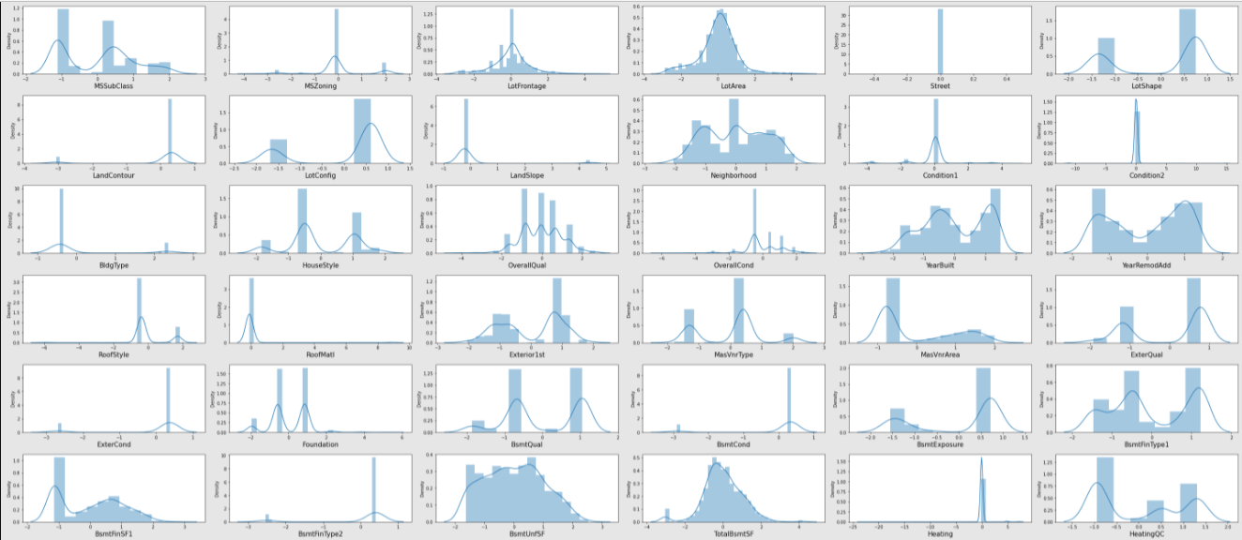
Distplot power transformation technique ‘yeo-Johnson’

Slide 22
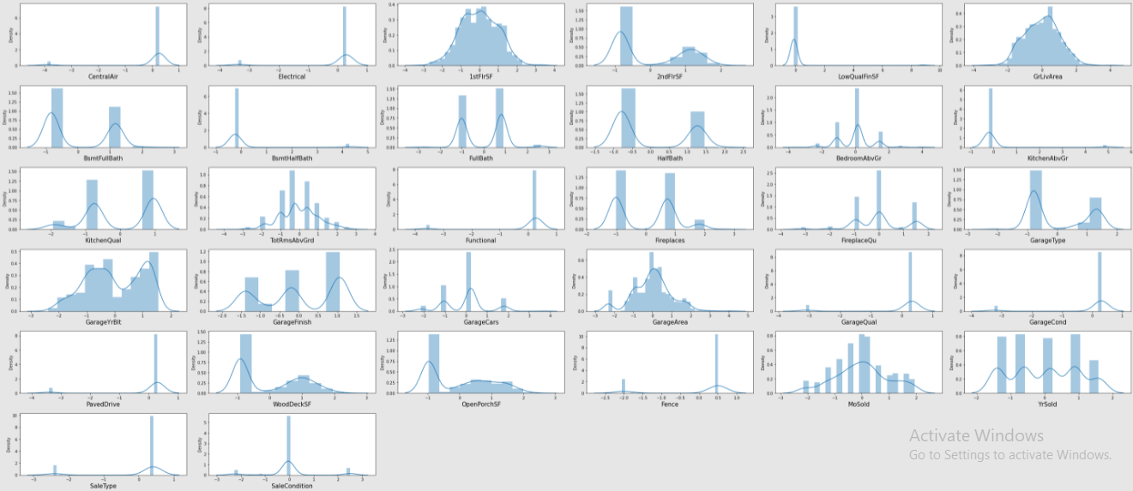
Distplot power transformation technique ‘yeo-Johnson’

Slide 23
Observation
After applying power transformation technique to treat the skewness in the data yeo-Johnson, skewness is decresed but some of columns still having lots of outlier so we will drop them.
These are some columns MiscVal, PoolArea, ScreenPorch, 3SsnPorch, EnclosedPorch, BsmtFinSF2, Exterior2nd

Slide 24
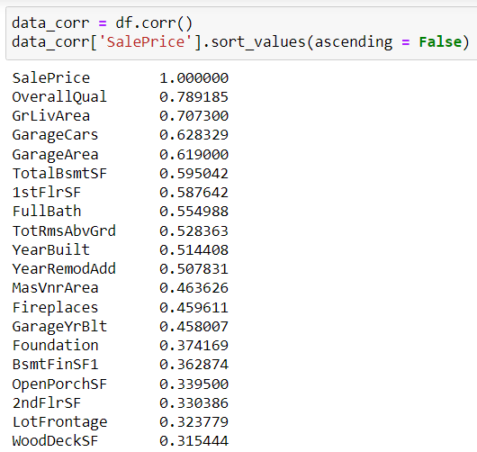
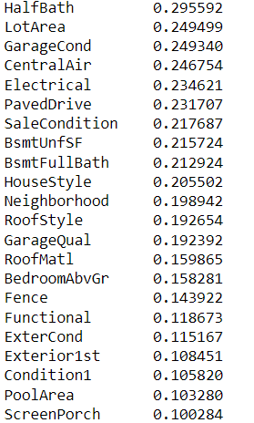
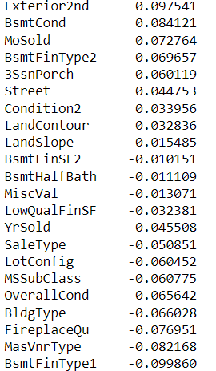
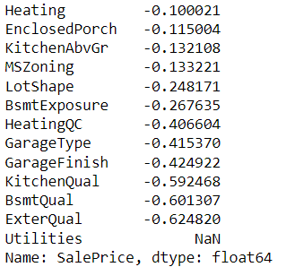
Pearson’s correlation coefficient
Pearson’s correlation coefficient to check the correlation between dependent and independent features

Slide 25
Observation
from corelation we can observe these are features are positively corelated with Sales price ,OverallQual, GrLivArea, GarageCars, GarageArea, TotalBsmtSF, 1stFlrSF, FullBath, TotRmsAbvGrd, YearBuilt, YearRemodAdd, MasVnrArea, Fireplaces, GarageYrBlt,Foundation, BsmtFinSF1, penPorchSF, 2ndFlrSF, LotFrontage, WoodDeckSF, HalfBath, LotArea, GarageCond, CentralAir, Electrical, PavedDrive, SaleCondition,BsmtUnfSF, BsmtFullBath, HouseStyle
And negatively corelated with Sales price these features are LotShape,BsmtExposure,HeatingQC,GarageType,GarageFinish,KitchenQual,BsmtQual,ExterQual
And Utilities having all NAN so we will drop Utilities

Slide 26
Data Cleaning Steps
In the datasets found null values in many columns also present outliers and also skewness.
I have used imputation method to replace null values.
To remove outliers used zscore method and data loss of 4.2%.
Removed skewness with yeo-johnson method.
To encode the categorical columns used Encoder to Ordinal encode the categorical data
Used Pearson’s correlation coefficient to check the correlation between dependent and independent features.
Also I have used standardization. Then followed by model building with all regression algorithms.

Slide 27
Observation : Exploratory Data Analysis
Statistical analysis like checking shape, nunique, value counts, info describe etc
While checking the info of the datasets I found some columns with more than 80% null values, so these columns will create skewness in datasets so I decided to drop those columns.
Then while looking into the value counts I found some columns with more than 85% zero values this also creates skewness in the model and there are chances of getting model bias so I have dropped those columns with more than 85% zero values.
While checking for null values I found null values in most of the columns and I have used imputation method to replace those null values (mode for categorical column and mean for numerical columns).
In Id and Utilities column the unique counts were 1168 and 1 respectively, which means all the entries in Id column are unique and ID is the identity number given for perticular asset and all the entries in Utilities column were same so these two column will not help us in model building. So I decided to drop those columns.
And all these steps were performed to both train and test datasets separately and simultaneously.

Slide 28
Model Building
Since SalePrice was my target and it was a continuous column so this particular problem
was regression problem.
Using Linear Regression we find R2 score and its corresponding random state
Done the train_test_split data with 75 training and 25 testing data
Now we will check accuracy with following Repressor algorithm and finalize one model
DecisionTreeRegressor()
Linear Regression
RandomForestRegressor()
KNeighborsRegressor()
AdaBoostRegressor()
GradientBoostingRegressor()
Lasso()
Ridge()
ExtraTreesRegressor()
XGBRegressor()

Slide 29
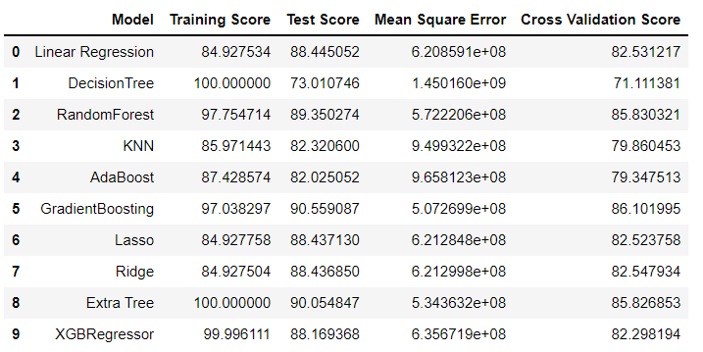
Fitting the data to various model and checking the accuracy

Slide 30
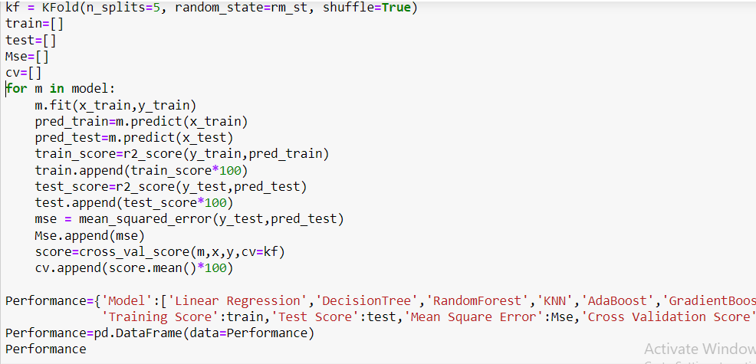
Fitting the data to various model and checking the accuracy

Slide 31
Observation: Following are the result over all 9 algorithms with respect to Training Score,Test Score,Mean Square Error and the Cross Validation Score
DecisionTree having 100% accuracy which is showing over fitting and maximum difference in test score and CV score. XGBRegressor is also somewhat showing overfitting.
Linear Regression, Ridge and Lasso are underfitting model as training score is less than testing score.
We can see GradientBoosting, Extra Tree and RandomForest regressor having comparative less Mean Square Error.
GradientBoosting, Extra Tree and RandomForest regressor Also test score and Cross Validation Score difference is also less.
So we will go for Hyper parameter tuning for GradientBoosting, Extra Tree and RandomForest regressor model and will choose best model out of them

Slide 32
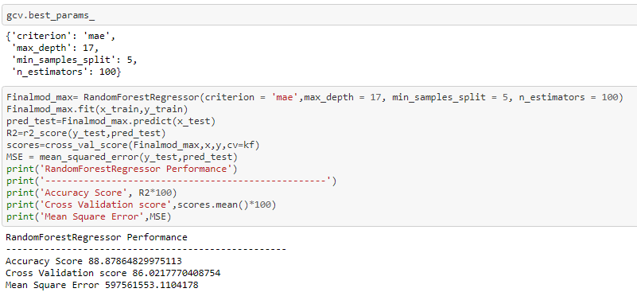
Hyper Parameter Tunning RandomForest Regressor
RandomForest Regressor, after tuning the model with best parameters we can see the decreased accuracy from 89.35% to 88.87% and Cross Validation Score almost same Also Mean Square Error values has increased which means error has increased so we will not go for this model.

Slide 33
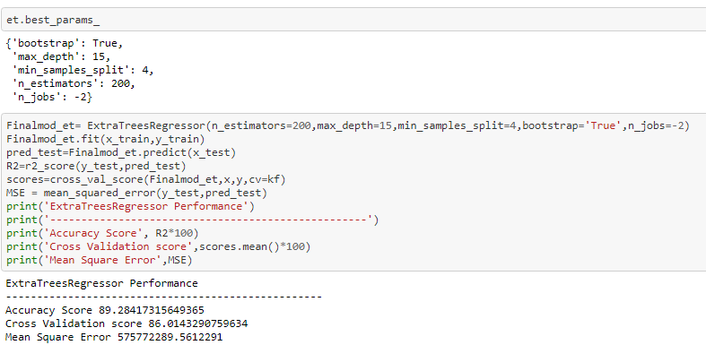
Hyper Parameter Tunning ExtraTreesRegressor
Extra Tree Regressor, after tuning the model with best parameters we can see the decresed accuracy from 90.05% to 89.28% and Cross Validation Score almost same Also Mean Square Error values has increased which means error has increased so we will not go for this model.

Slide 34
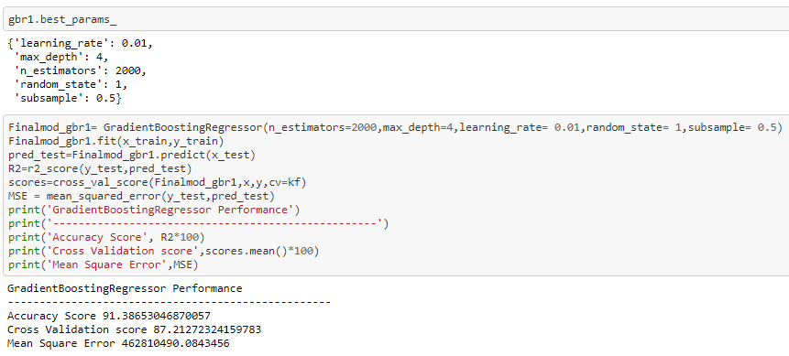
Hyper Parameter Tunning GradientBoosting Regressor
Finally we selected GradientBoosting Regressor, after tunning the model with best parameters we can see the incresed accuracy from 90.55% to 91.39% and Cross Validation Score from 86.10% to 87.21% Also Mean Square Error values has reduced which means error has reduced.

Slide 35
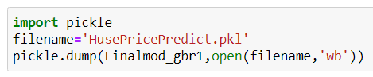
Saving the model and predictions using saved model
Save best model using .pkl as follows.
Now after saving the best model, loading my saved model and predicting the test values.
Predicted the SalePrice for test dataset(25% of train dataset) using saved model of train dataset, and the predictions look good.
Also Predicted the SalePrice for test dataset using saved model of train dataset.

Slide 36
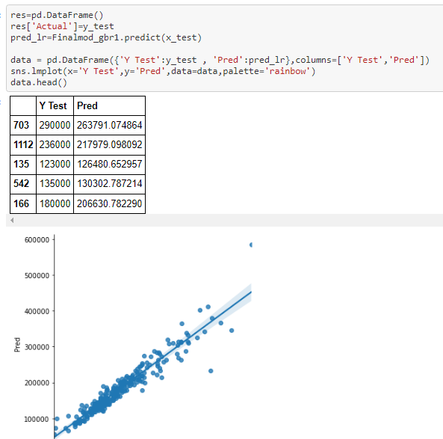
Best Model Saving
Predicted the SalePrice for test dataset(25% of train dataset) using saved model of train dataset, and the predictions look good.

Slide 37
Conclusion
In this project report, we have used machine learning algorithms to predict the house prices.
We have mentioned the step by step procedure to analyze the dataset and finding the correlation between the featuers. Thus we can select the features which are not correlated to each other and are independent in nature.
Those feature sets were then given as an input to nine algorithms
Hence we calculated the performance of each model using different performance metrics and compared them based on these metrics. Then we have also saved the dataframe of predicted prices of test dataset.
To conclude, the application of machine learning in property research is still at an early stage. We hope this study has moved a small step ahead in providing some methodological and empirical contributions to property appraisal, and presenting an alternative approach to the valuation of housing prices.
Future direction of research may consider incorporating additional property transaction data from a larger geographical location with more features, or analysing other property types beyond housing development.

Slide 38
Thank You

